Slide 1

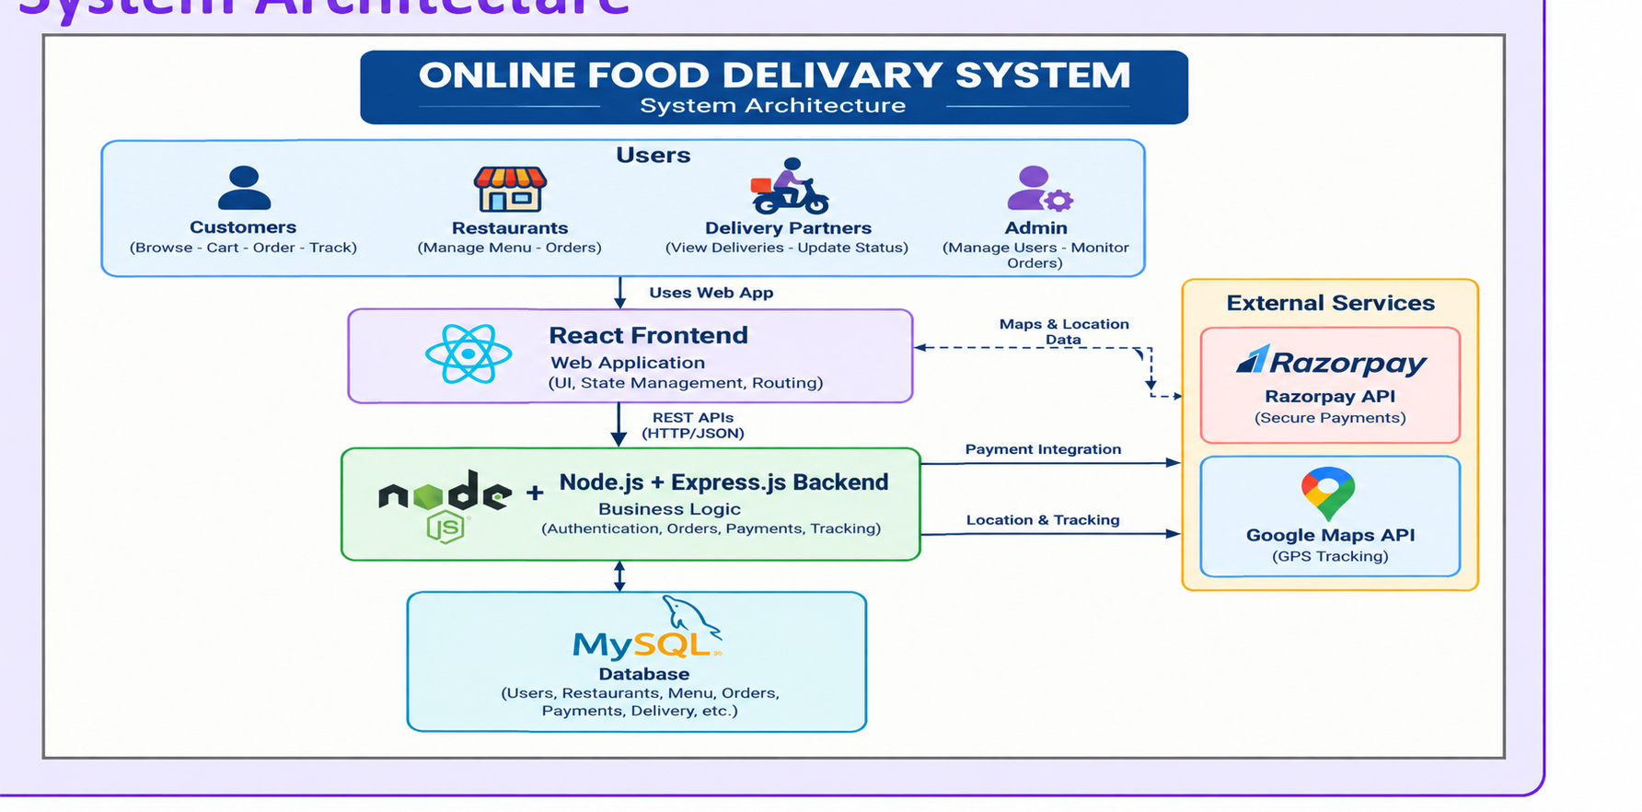
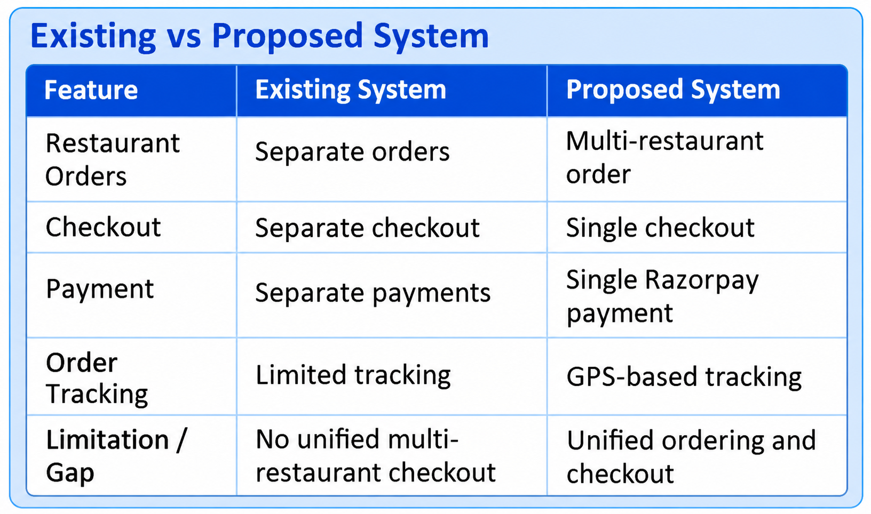
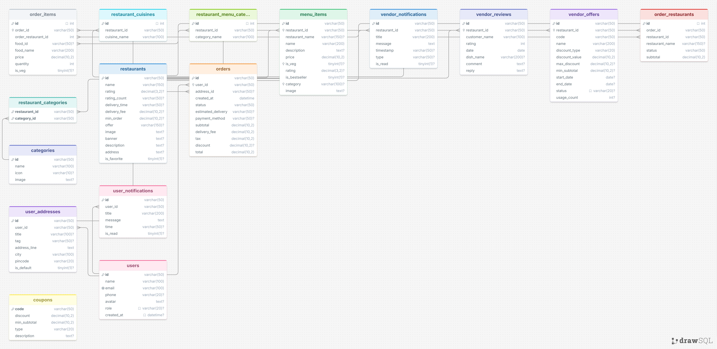
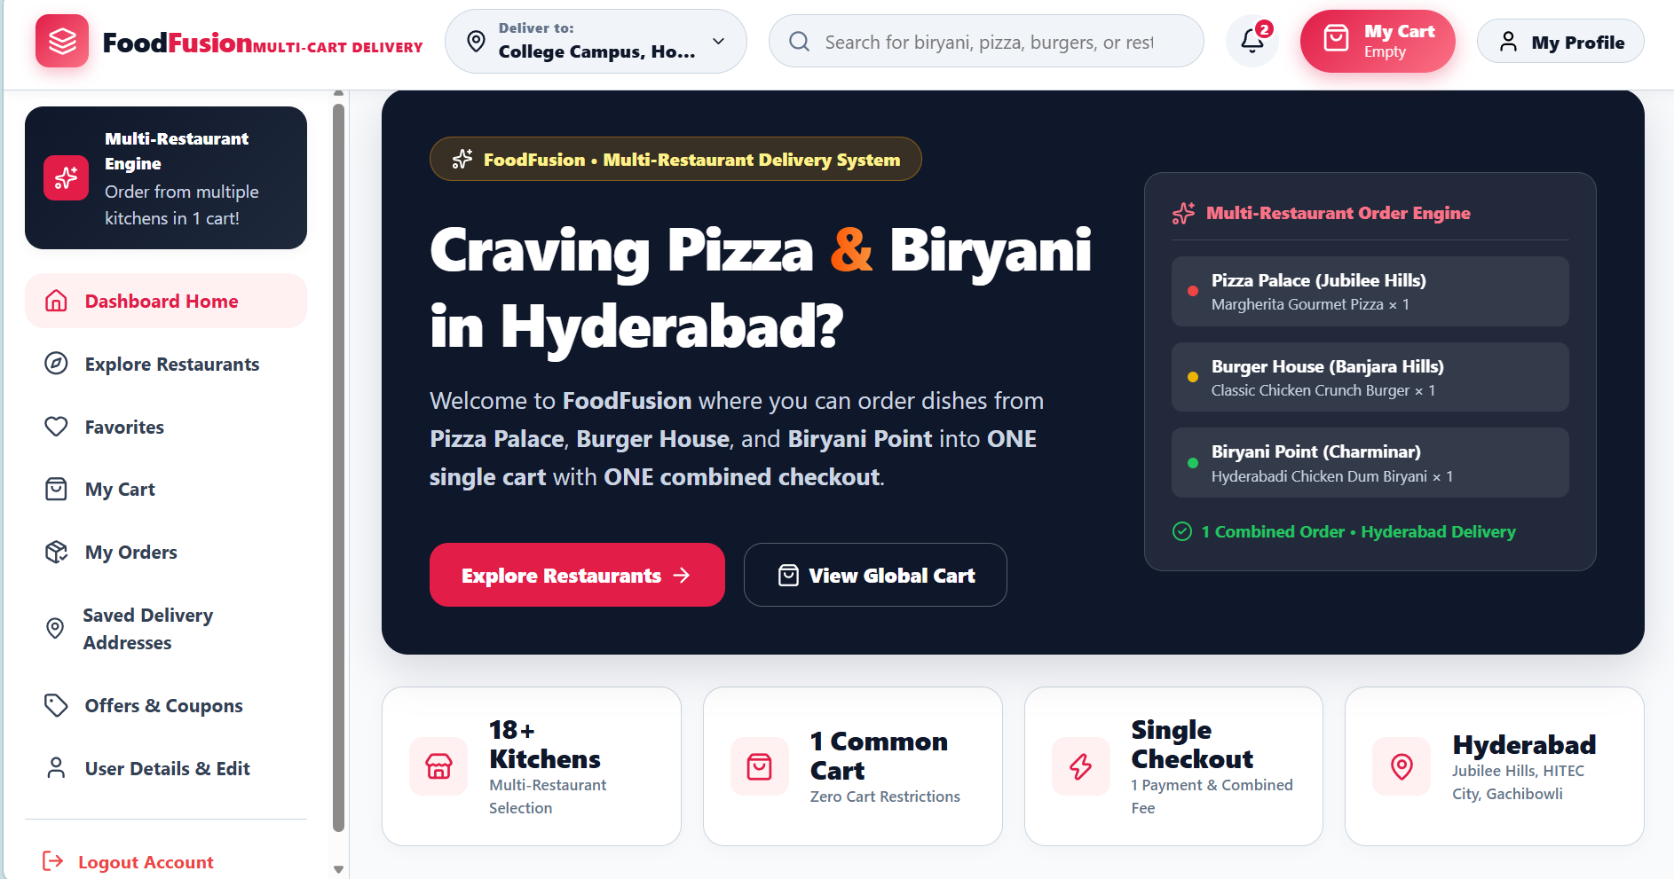
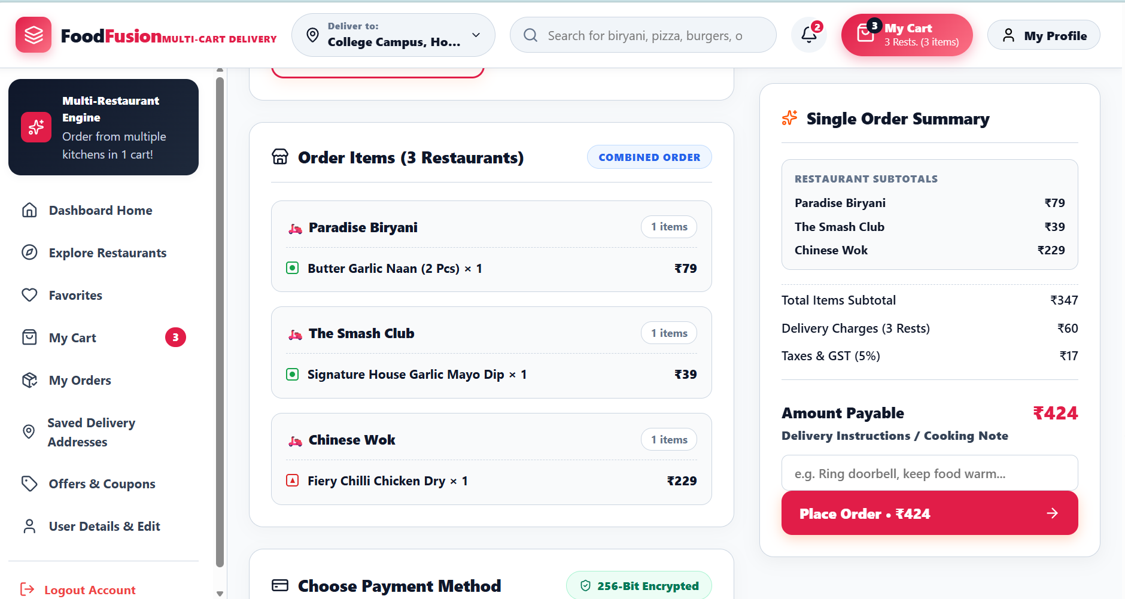

Online Food Delivery Platform: Multi-Restaurant Ordering & Unified Checkout
Team ID: [13] | Section: [S9] | Members: [Samhitha-2520030509], [Sahasra-2520030108], [Tejaswini-2520030510] | Guide: [Dr. Y. Prashanthi]
Database Systems Engineering and Distributed Backend Development (25CS1302E) | KLH Bachupally Campus, CSE | PBL 2026-27
KLH Logo
Abstract
Tools & Technologies
A smart food delivery system that enables customers to order food from multiple restaurants through a single cart and checkout. It integrates restaurant management, Razor pay payments, and GPS-based delivery tracking using Google Maps API.
Main outcome: A convenient and unified food ordering and delivery experience.
Front-End: React / HTML-CSS-JS
Back-End: Node.js, Express.js
Database: MySQL
Tools: Git & GitHub, Postman, VS Code, Draw.io
Problem Statement & Objectives
Problem: Separate checkouts are required for different restaurants. Our system enables multi-restaurant orders with a single checkout. payment and tracking processes.
Objective 1: Multi-restaurant ordering
Objective 2: Single checkout and payment
Objective 3: GPS-based delivery tracking
Scope: Customer ordering, restaurant management, payments, and delivery tracking.
System Architecture
ER Diagram & Database Design
Feasibility Study
Technical: [Required skills, tools and platform availability]
Economic: [Cost – open-source stack, free-tier hosting]
Operational: [User acceptance, ease of use, maintenance]
Schedule: [Completion within the semester timeline]
Implementation Screenshots
[Screenshot 1]
[Screenshot 2]
Results & Testing
Conclusion
Future Scope
[Successfully implemented and tested unified cart, single checkout, master-order processing, and restaurant-specific order handling.]
[Tested ordering food from multiple restaurants using one cart and single checkout.
Tested order processing and tracking successfully]
[Our platform allows users to order food from multiple restaurants in one order].
[It provides one cart and a single checkout, making food ordering easier.]
[AI-based food recommendations and personalized suggestions]
[rewards, more payment options, and support for more cities]
QR: GitHub

